Slide 1
A Project Presented On
“BENEFICIARY SELECTION SYSTEM FOR WCD”
Presented By Rakesh Kumar Sharma MCA -VI Sem. Roll No. 0001752817
Year : 2019-2020
Internal guide: Project Guide:
Dr. V.K. Patle Mr. Ashok Kumar Banjare Assistant Professor Sr. Technical Director S.o.S in Computer Science & IT NIC, Mahanadi Bhawan, PT.RSU , Raipur(C.G) Atal Nagar (C.G.)
Submitted to
S.o.S in Computer Science& Information Technology
Pt. Ravishankar Shukla University, Raipur
Chhattisgarh

Slide 2
CONTENTS
Abstract
Introduction
Problem description
Proposed Solution
Module Description (User)
Tools – Frontend & Backend
DFD
Flowchart
ER Diagrams
Testing
Input & Output Forms
Conclusion
Future Enhancement
References

Slide 3
ABSTRACT
In this project, we propose a system for Beneficiary Selection System For Woman And Child Development (User Module).
This project helps the department in informing the beneficiaries about the correct schemes, and the benefits of the scheme to the deserving candidate.
At the same time, it helps administrator by taking out the report on the time and by region.

Slide 4
INTRODUCTION
About the Project :
Beneficiary Selection System is a web application for users to select and apply for useful scheme according to their requirement and eligibility.
This project is to manages user personal details, scheme requirement details, including record maintenance .
About the Company
COMPANY NAME : National Informatics Centre (NIC), Naya Raipur
National Informatics Centre (NIC) was established in 1976, and has since emerged as a "prime builder" of e-Government / e-Governance applications up to the grassroots level as well as a promoter of digital opportunities for sustainable development.

Slide 5
PROBLEM DESCRIPTION
Manual process and Difficult to get data.
Maintenance of the records is difficult.
Involves large amount of paper work.
Time consuming process.
Slow Updating and Renewal of Data.
PROPOSED SOLUTION
Very simple and easy to use.
Less time consuming.
All registered User detail.
Administrator discretion and control over the entire system.
Reduces manual data entry.
Easy to get complete reports of each entry forms

Slide 6
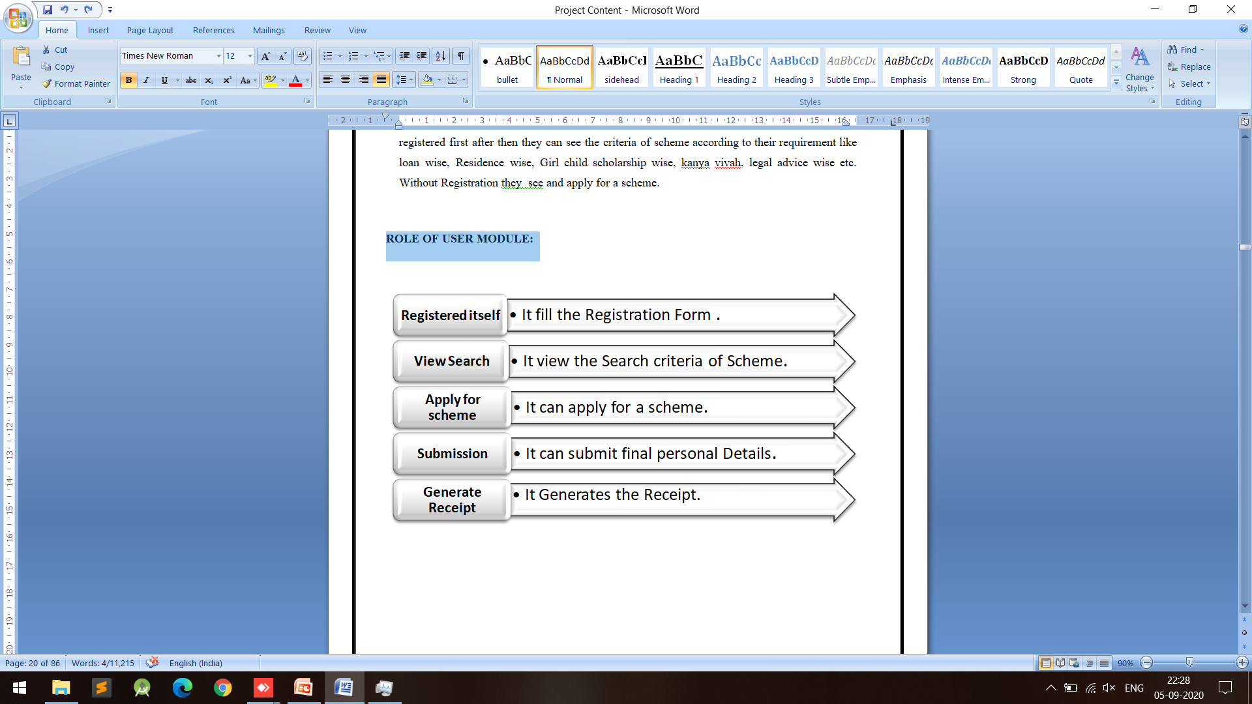
MODULE DESCRIPTION : User MODULE
User can search a scheme and also apply for it. User who want to apply for a scheme they should registered first after then they can see the criteria of scheme according to their requirement like loan wise, Residence wise, Girl child scholarship wise, legal advice wise etc. User only see a scheme without Registration.
This project follows the prototype model.

Slide 7
TOOLS – FRONTEND & BACKEND
HARDWARE REQUIREMENTS
Processor : Minimum 1.2 GHz, Dual Core or above
RAM : Minimum 4 GB or above
Internal Storage : 500 GB (Recommended) or above
Mouse : Optical (Recommended)
Keyboard : Multimedia (Recommended)
Monitor : 14" or above
Web Presentation : HTML, CSS, Bootstrap, Angular Material
Client – side Scripting : Angular 9
Database : MariaDB, HeidiSQL
Operating System : Windows 7 or above
Server – side Scripting : Node.JS
Supported Browsers : Google Chrome / Firefox / Opera / Internet Explorer
SOFTWARE REQUIREMENTS

Slide 8
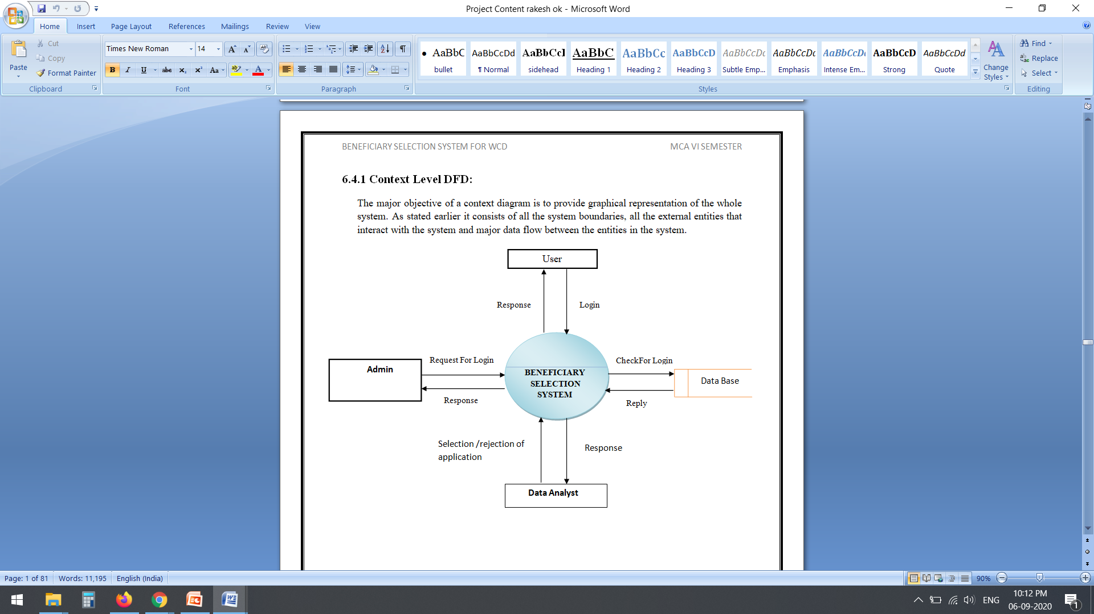
Context Level DFD
The major objective of a context diagram is to provide graphical representation of the whole system. As stated earlier it consists of all the system boundaries, all the external entities that interact with the system and major data flow between the entities in the system.

Slide 9
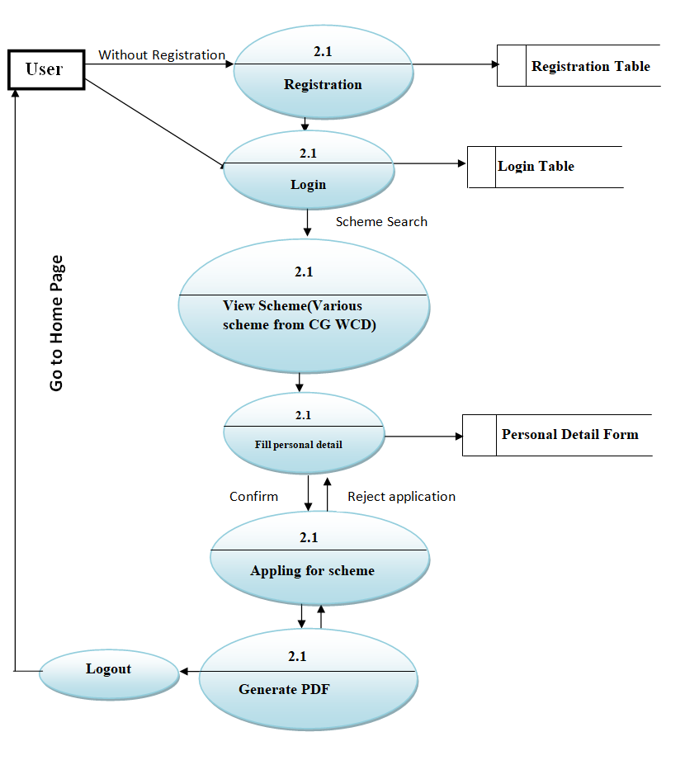

Slide 10
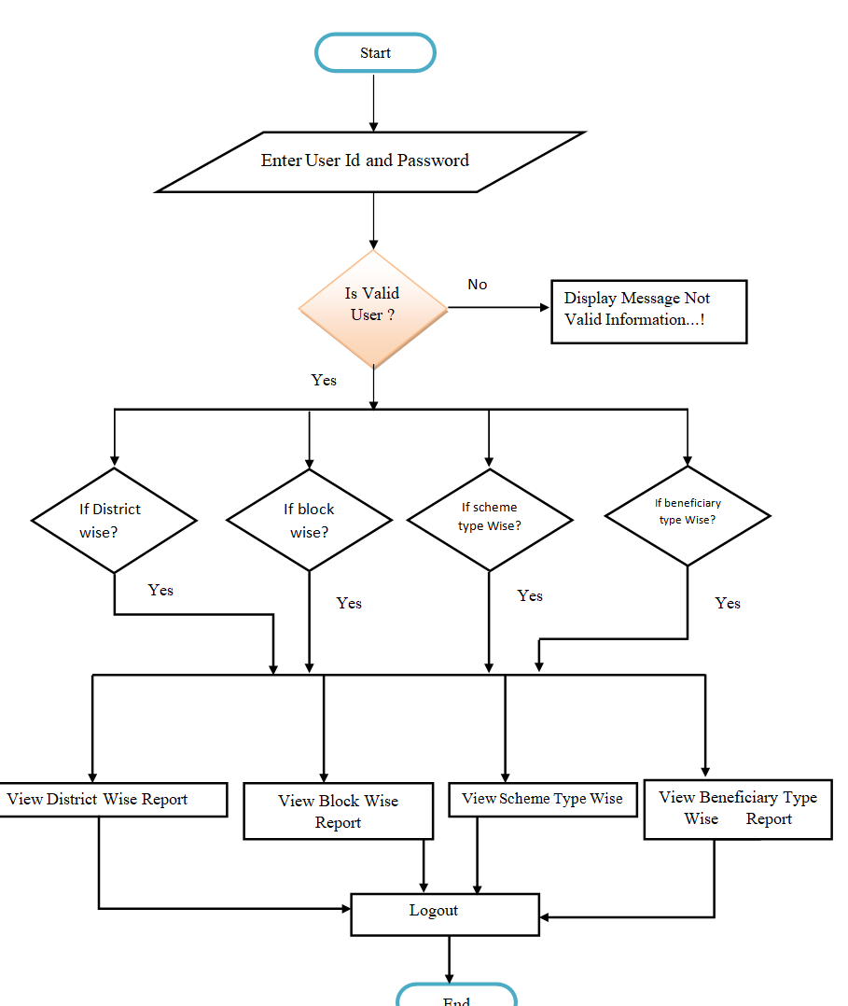
FLOWCHART

Slide 11
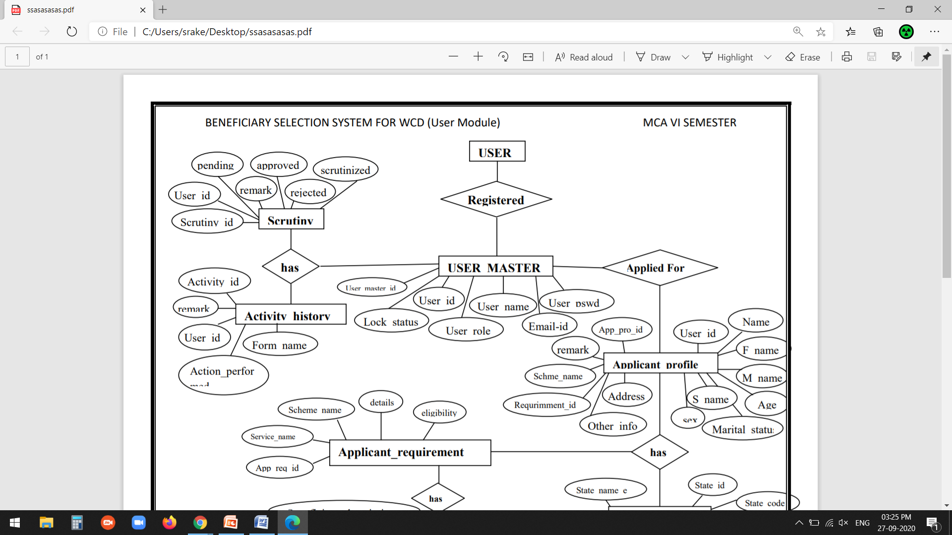
ER DAIGRAM

Slide 12
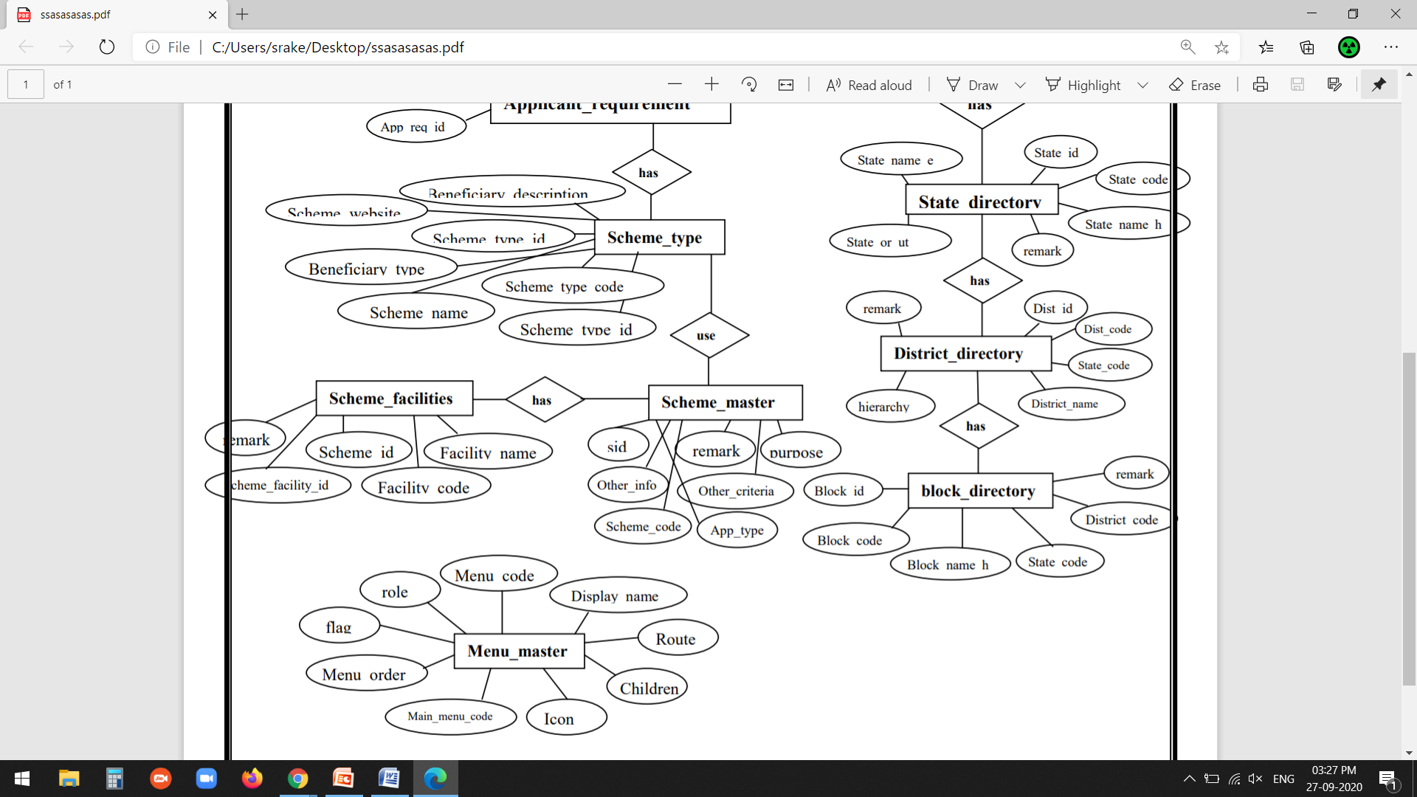

Slide 13
TESTING
Testing is the process of detecting errors. Testing performs a very critical role for quality assurance and for ensuring the reliability of software and application.
White Box Testing: In the project, based on an analysis of the internal structure design/implementation of the component or system.
- Unit testing
- Integration testing
Black Box Testing: Black Box Testing is a software testing method in which the internal structure / design / implementation of the item being tested is not known to the tester. In this testing tester has not required the programming knowledge and implementation knowledge .
- System testing

Slide 14
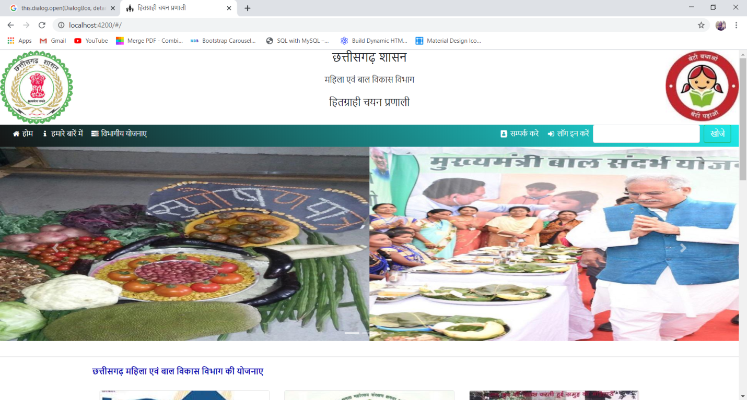
INPUT & OUTPUT FORMS (Welcome Forms)

Slide 15
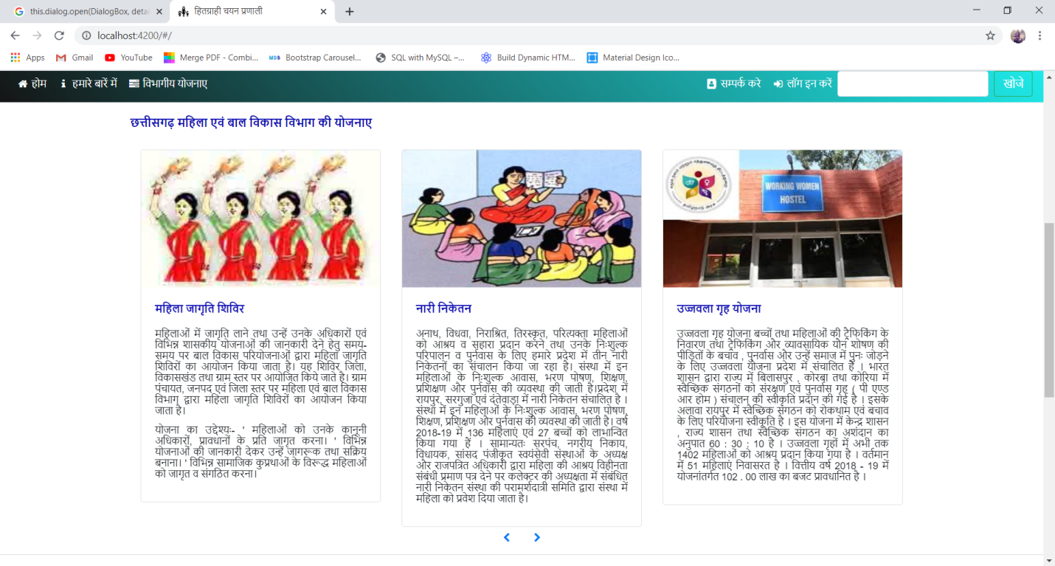
Departmental Scheme Forms

Slide 16
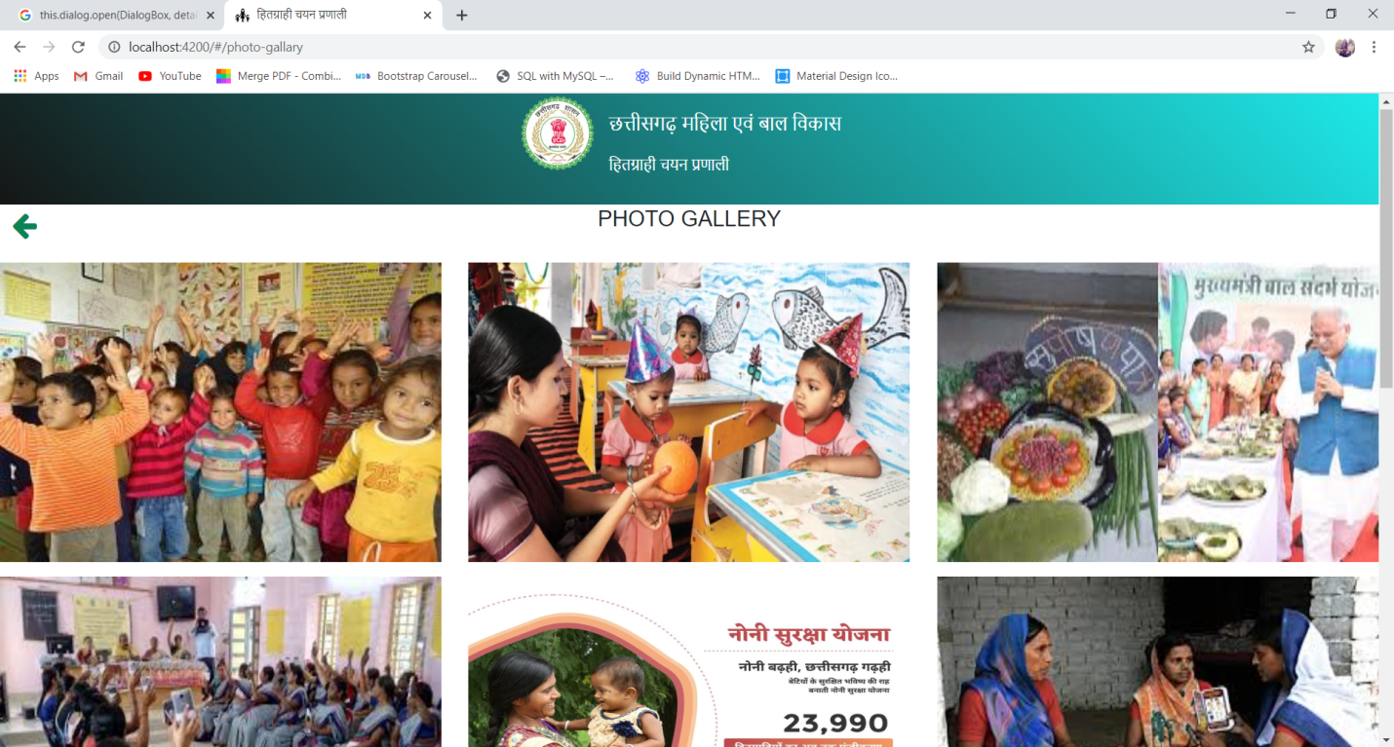
Photo Gallery Forms

Slide 17
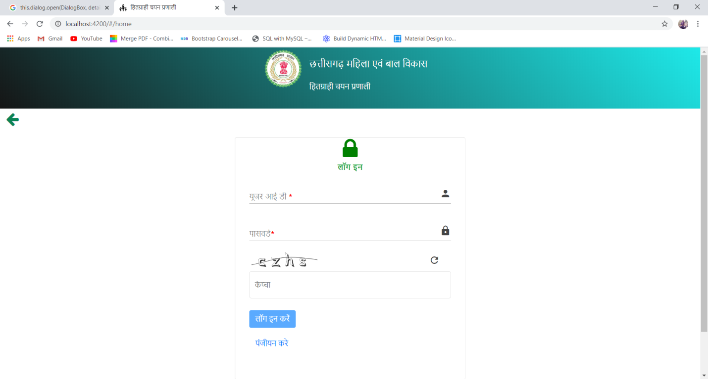
Login Form Forms

Slide 18
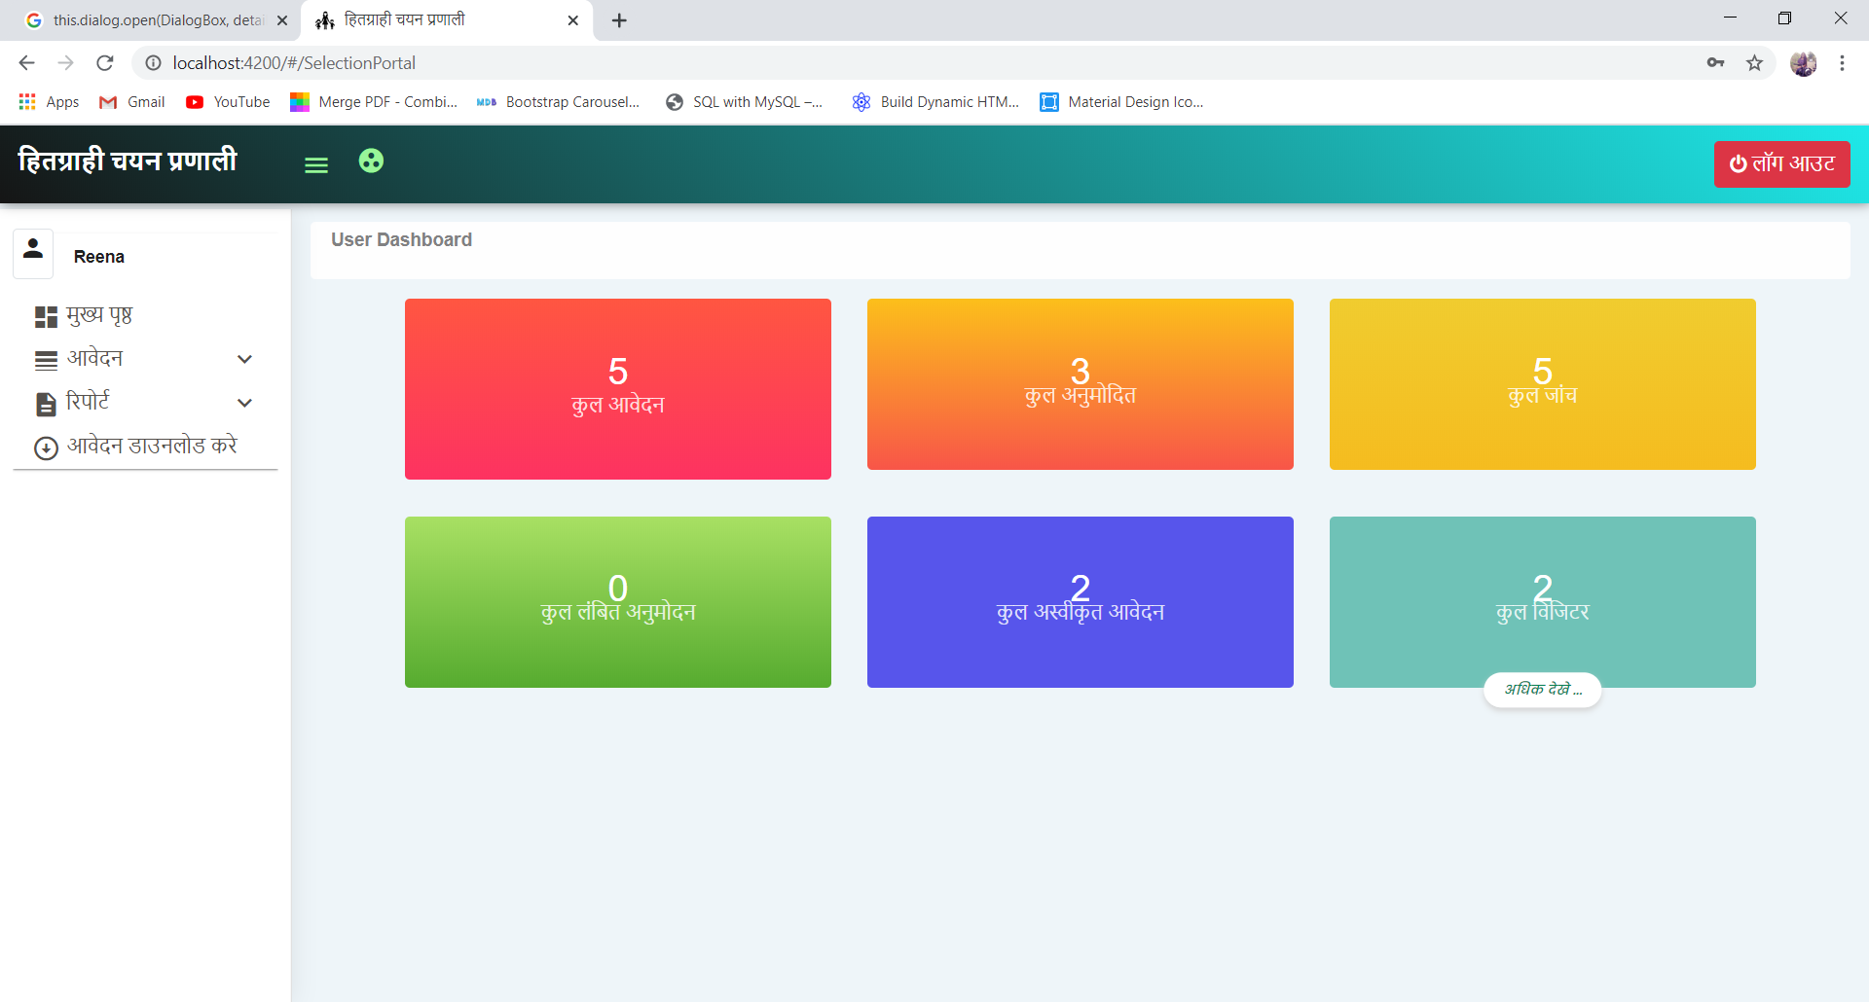
User Login Dashboard

Slide 19
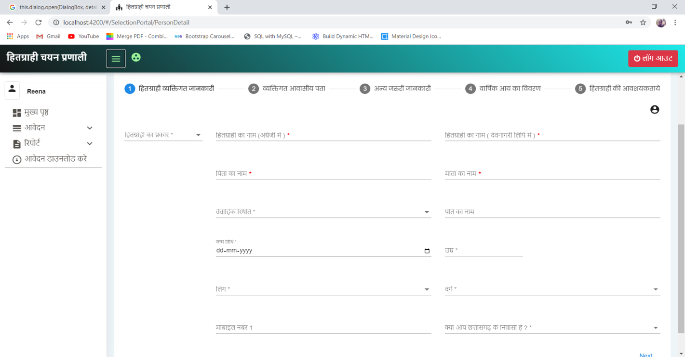
User Personal Detail

Slide 20
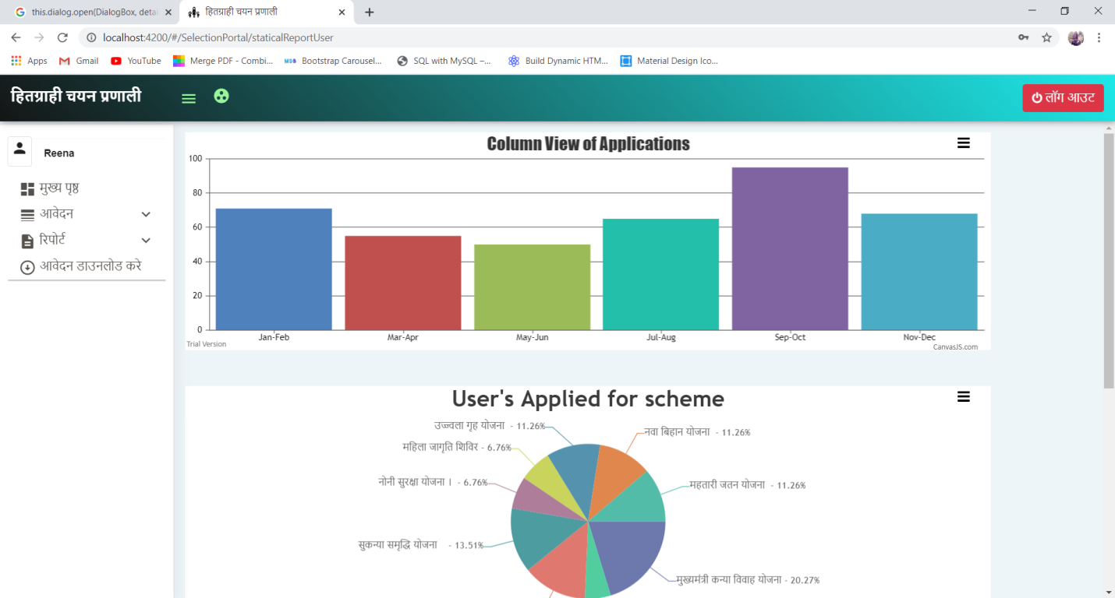
User Statically Report

Slide 21
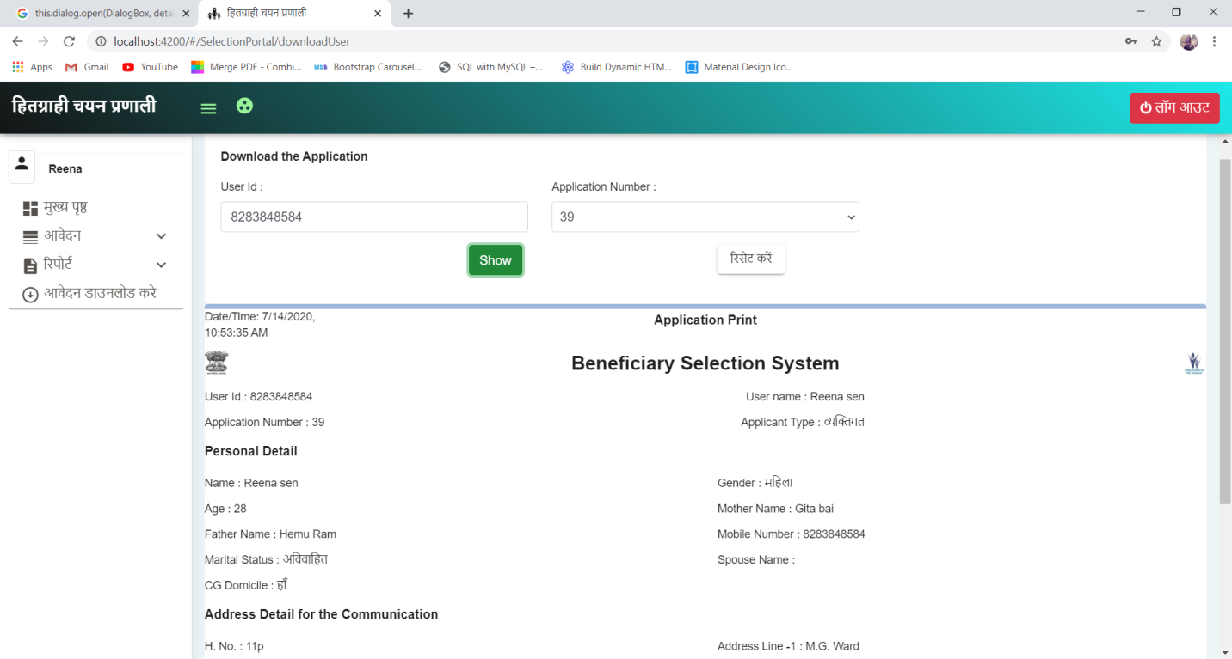
Application Download

Slide 22
CONCLUSION
The module provide scope for further enhancement depending upon user’s requirement. Finally it can be concluded that the overall “BENEFICIARY SELECTION SYSTEM” - (USER) module of this Website is implemented successfully.
Now after the development of “Beneficiary Selection System”, maintaining data for Organization has become easier as compared to the earlier system.
The entry of data and report finding will become very easy with accuracy and without redundancy.
User will acknowledge about application by receiving E-Mail.

Slide 23
FUTURE ENHANCEMENT
User requirements keep changing as the system is being used. Some of the future enhancements that can be done to this system are:
Remote access
- Database access from anywhere cloud services provide.
OTP/SMS Notification
- New system provides new functionality.
AI Based Automated System
The above mentioned points are the enhancements which can be done to increase the ability and usage of this project.

Slide 24
REFERENCES
REFERENCE BOOKS
- Gud Apps Provided By NIC
WEB REFERENCES
-https://www.w3schools.com/nodejs
-https://material.angular.io/
-https://angular.io
-https://www.tutorialspoint.com/nodejs
-https://stackoverflow.com
-https://www.npmjs.com

Slide 25
Thank You

